Slide 1
BRASS Scenario 1
Mission Suddenly Requires Higher Bandwidth For Safety of Flight Data
F-22 Coating Upgrades
Adapted from a flight test that occurred in 2005

Slide 2
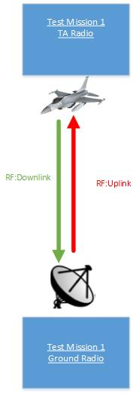
Scenario #1 – Brief Description
A fighter has a mission with a fixed scheduled transmission bandwidth. During the flight test, flight crew encountered heavy vibration. As a result, the requirement for safety data increased to make sure everything is fine. Now the mission needs a higher amount of bandwidth to be able to send the safety data down to the ground station, in order to continue to fly. For this scenario, range bandwidth is available.
Voice and safety data need to be guaranteed for the test mission to be successful.

Slide 3
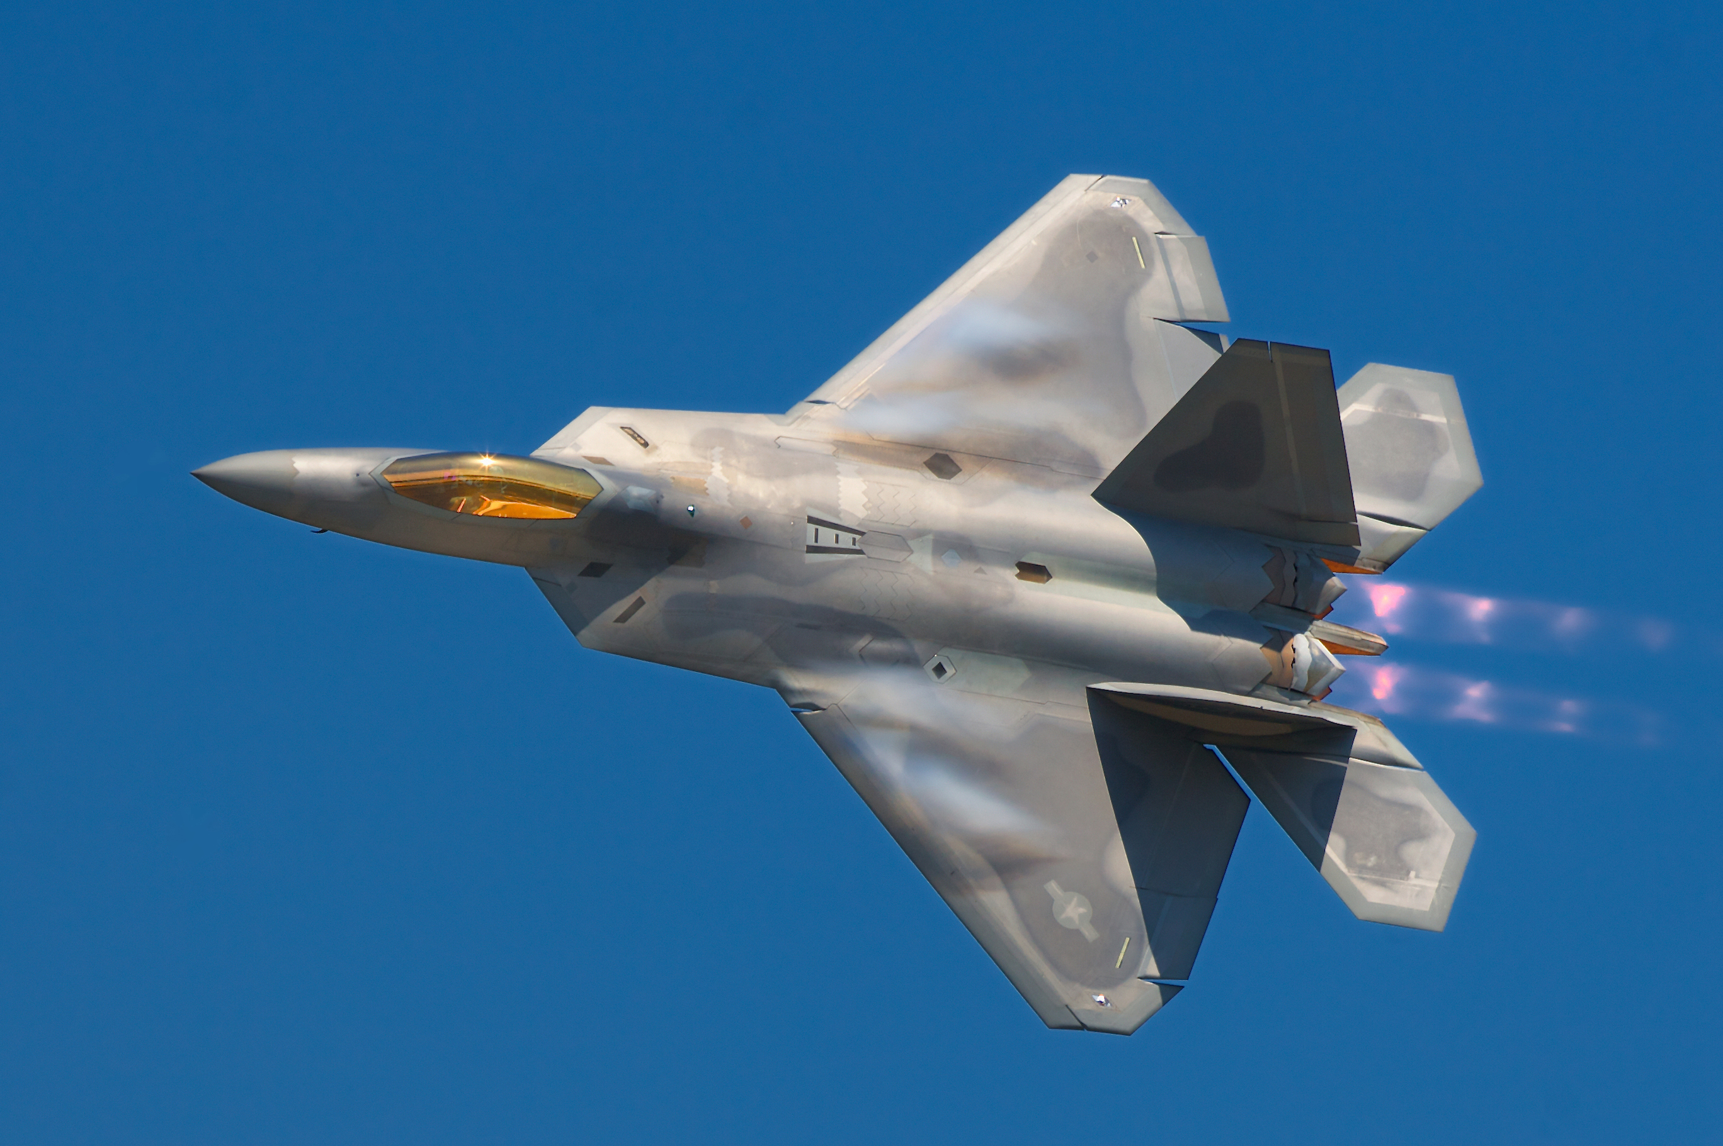
Test Article
Aircraft: F-22 Raptor

Slide 4
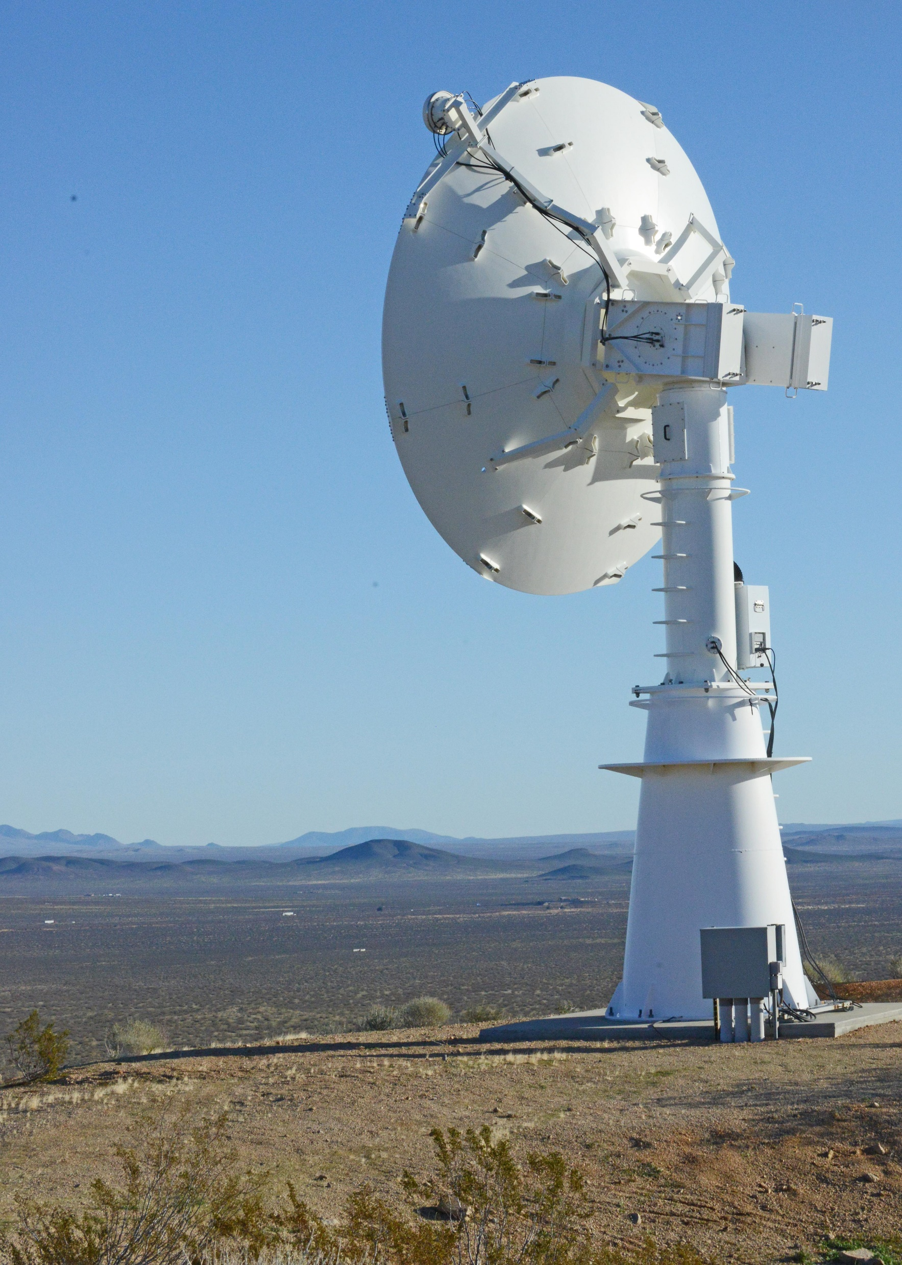
Range Infrastructure
Range Network: Typical large military range e.g. Edwards Air Force Flight Test Center
Equipment Used:
Ground Station Tracking Antenna and related network infrastructure
MCR processing live data
Equipment Available:
All in use

Slide 5
Static Scheduling
Before the start of the mission the radios are individually configured for the described test mission with the following QoS (Quality of Service)
Voice: 50 Kb/s
Safety: 100 Kb/s
Voice and safety needs to be guaranteed during the entire mission
Bulk: 1000 Kb/s

Slide 6
Flight Test Operation Flow

Slide 7
Associated Constraints
Physical limit on amount of bandwidth that can be achieved
Schedule must be valid
Latency should be constrained under 50ms

Slide 8
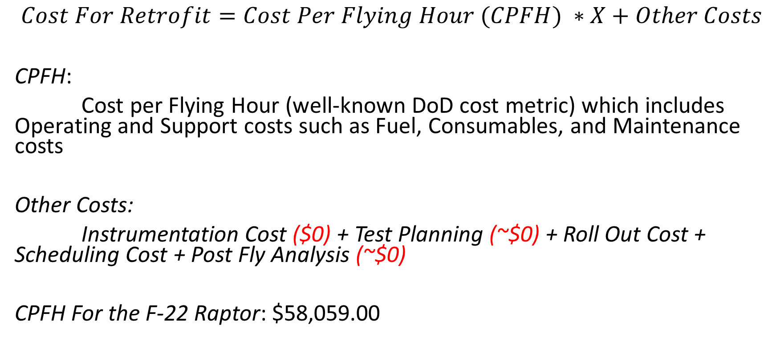
Cost Metrics
$$Cost For Retrofit=Cost Per Flying Hour (CPFH) ∗X+Other Costs$$
CPFH:
Cost per Flying Hour (well-known DoD cost metric) which includes Operating and Support costs such as Fuel, Consumables, and Maintenance costs
Other Costs:
Instrumentation Cost ($0) + Test Planning (~$0) + Roll Out Cost + Scheduling Cost + Post Fly Analysis (~$0)
CPFH For the F-22 Raptor: $58,059.00
Assumptions:
(1) Aircraft was already instrumented
(2) We approximate the Rollout Costs and Scheduling Costs to be ~ the cost of an hour cost

Slide 9
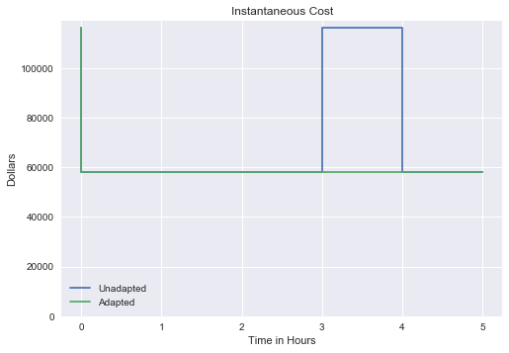
Cost Metric Instantaneous Cost
Unadapted - FT mission encountered a problem after t=3 which required landing and repeat the test again
Adapted - FT mission was accomplished successfully without having to land

Slide 10
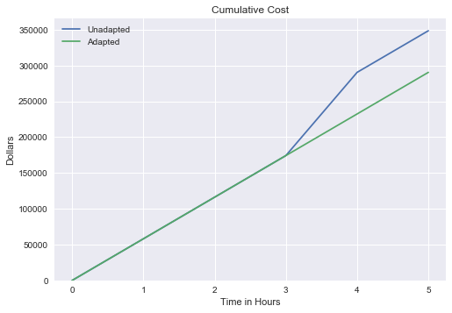
Cost Metric Cumulative Cost

Slide 11
Program Value Function
Maneuver value is the purpose of the flight test
Flight value is some value gained by having the plane in the air

Slide 12
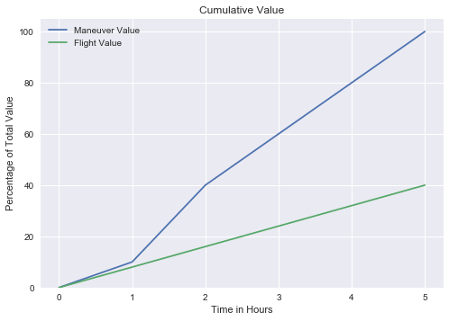
Program Value Function

Slide 13
Risk Metric
Measures the future uncertainties in achieving the test mission within the defined cost and schedule constraints
Risk Probability that a particular event will occur
Level | Value | Criteria
5 | Near certainty | Everything points to this becoming a problem
4 | Very likely | High chance of this becoming a problem
3 | Likely (50/50) | There is an even chance this may turn into a problem once in a while
2 | Unlikely | Risk like this may turn into a problem once in a while
1 | Improbable | Not much chance this will become a problem

Slide 14
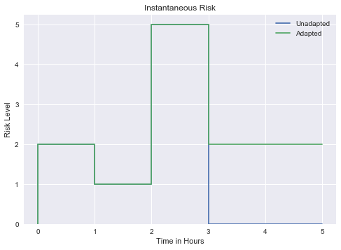
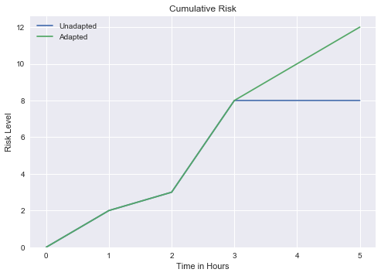
Risk Metric

Slide 15
Requirement Changes after Event Happens
 | Requirements Before Event | Requirements After Event
Voice | 50 Kb/s | 50 Kb/s
Safety | 100 Kb/s | 150 Kb/s
Bulk | 1000 Kb/s | 1000 Kb/s

Slide 16
QoS Policies
Where is QoS Policy defined in MDL?
<TestMission>\<QoSPolicy>\ServiceLevelProfiles
The Mission Service Level Profiles (MSLP) are defined for each link to handle Quality of Service (QoS) IP routing across the RF links that are defined for radio to radio wireless RF communication
Each MSLP defines a specific set of rules for IP routing that are applied to the RadioLink that is referenced

Slide 17
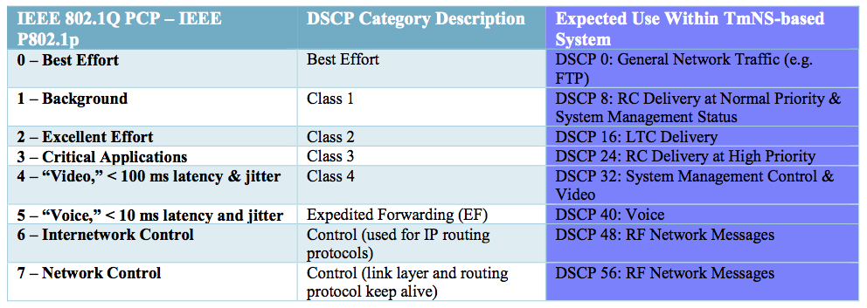
Priority Levels
Notes:
Eight different classes of service are available as expressed through the 3-bit PCP field in an IEEE 802.1Q header added to the frame. The way traffic is treated when assigned to any particular class is undefined and left to the implementation.
Voice, or things that are < 10 ms
Voice has its own latency profile

Slide 18
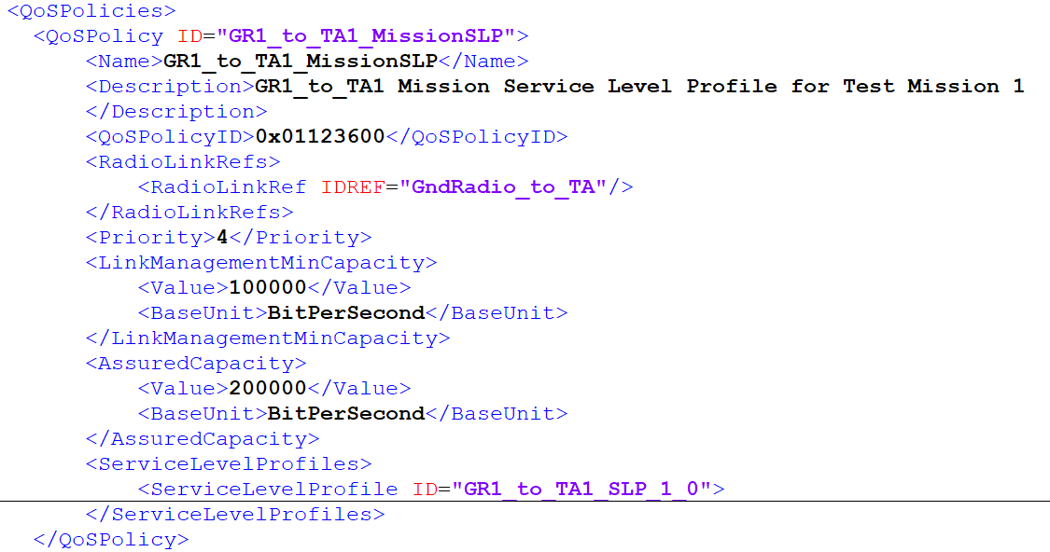
QoS Policy in MDL
Where do we set the QoS Policies for the uplink and downlink radio link?

Slide 19
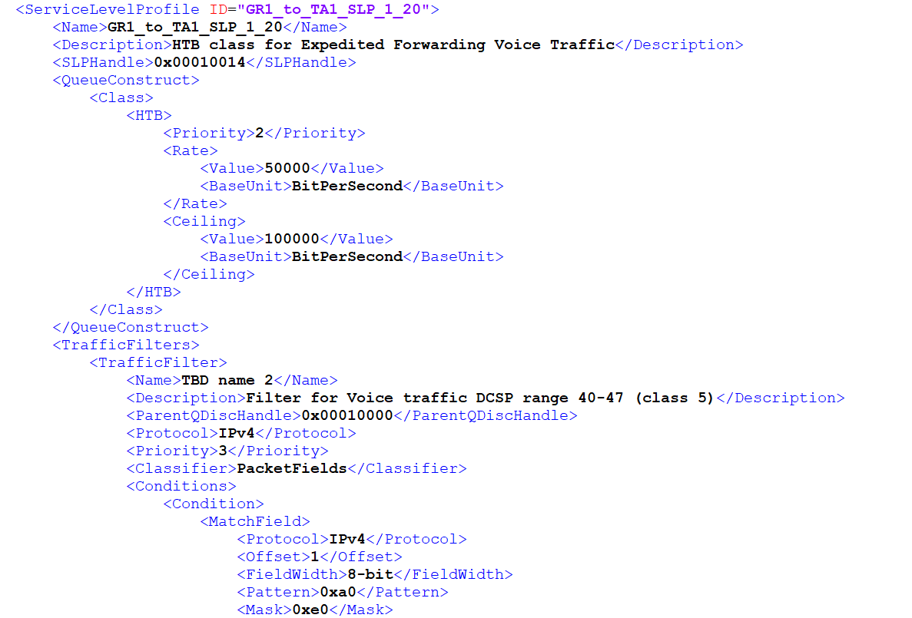
Voice Requirement in MDL
Downlink and Uplink
Voice: 50 Kb/s

Slide 20
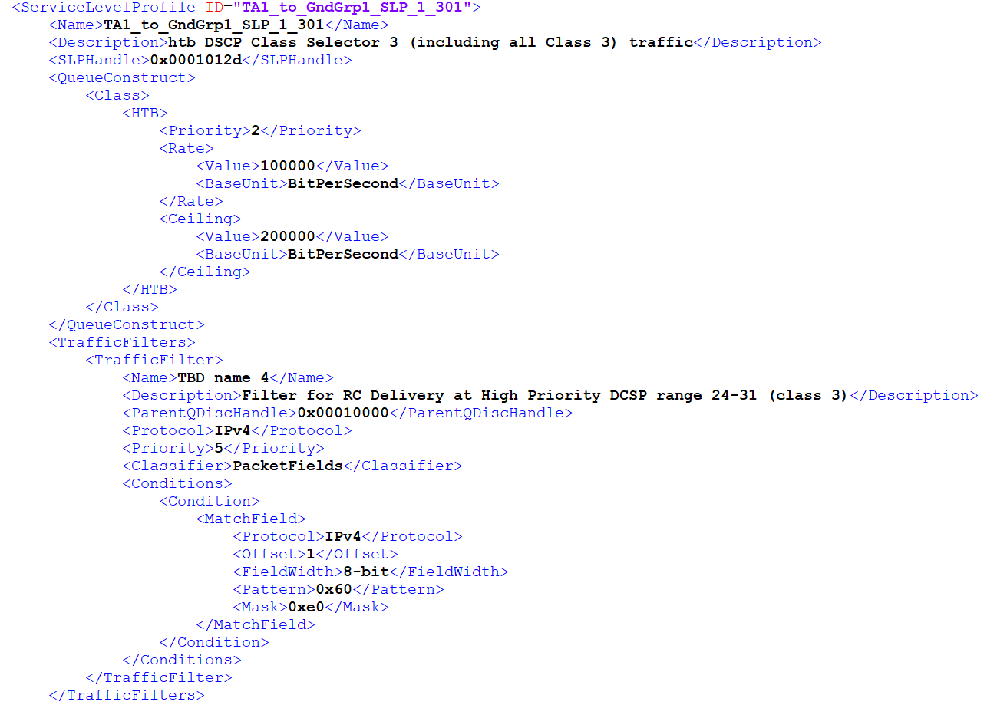
Safety Requirement in MDL (Before)
Downlink
Safety: 100 Kb/s

Slide 21
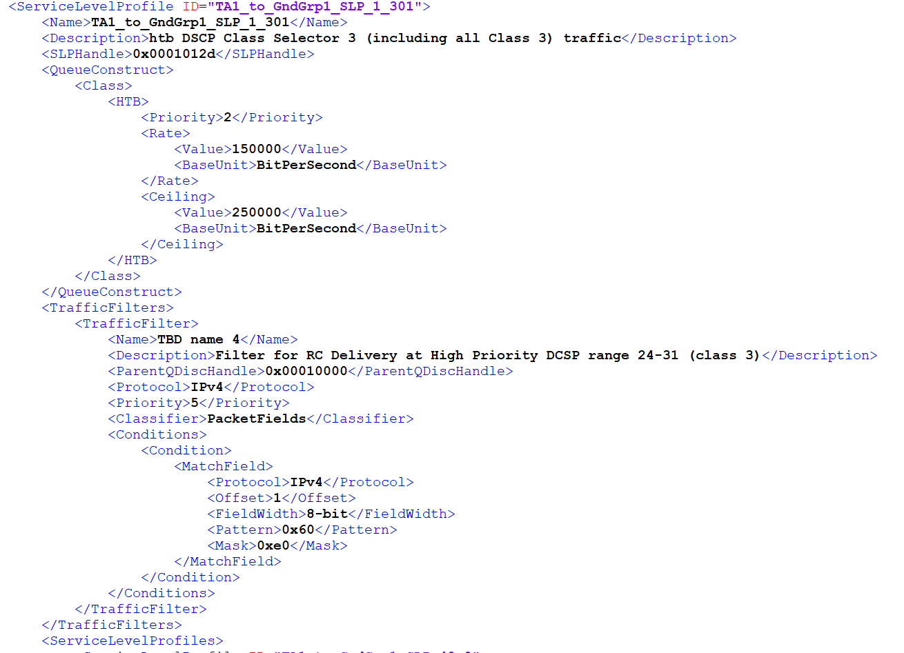
Safety Requirement in MDL (After)
Downlink
Safety: 150 Kb/s

Slide 22
Classic Solution
Land and abort test
Increases cost of testing because we will have to start the test over
Impact flight test schedule
No MDL changes needed for this solution

Slide 23
Suggested Solution
MDL Reconfiguration
RadioLink element is where most of the changes need to be done for both Radio (TA and Ground)
Describes a one-way connection two radio point
TransmissionSchedule element which describes the scheduling parameters for a static schedule
In this case we need to schedule TxOp assignment for the TA Radio and the Ground Radio as appropriate for the scenario requirement change

Slide 24
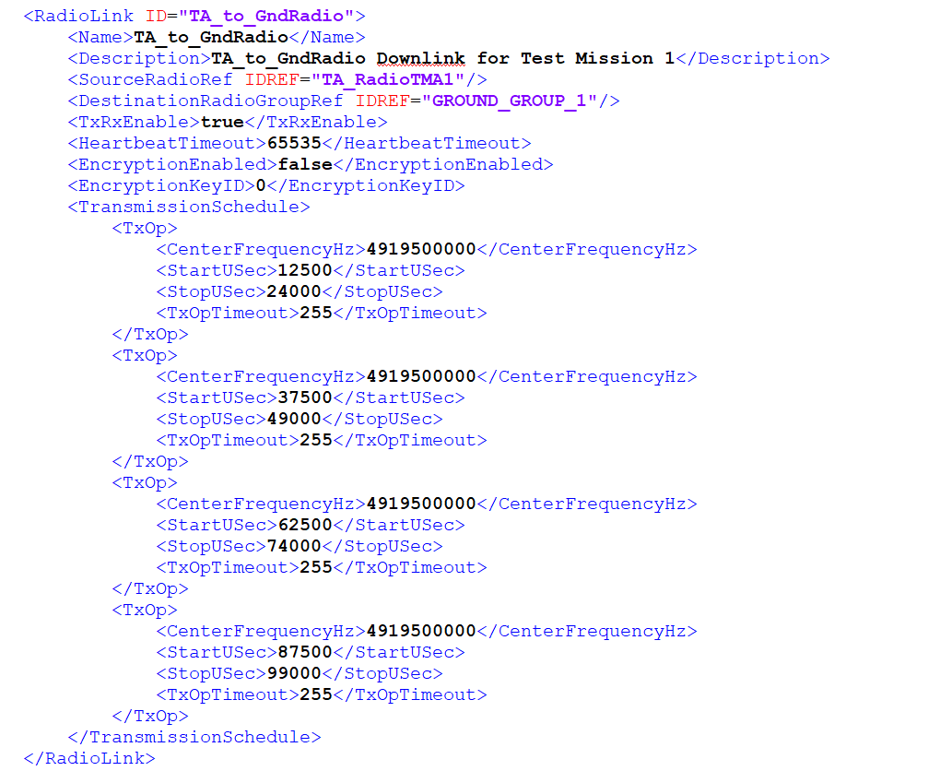
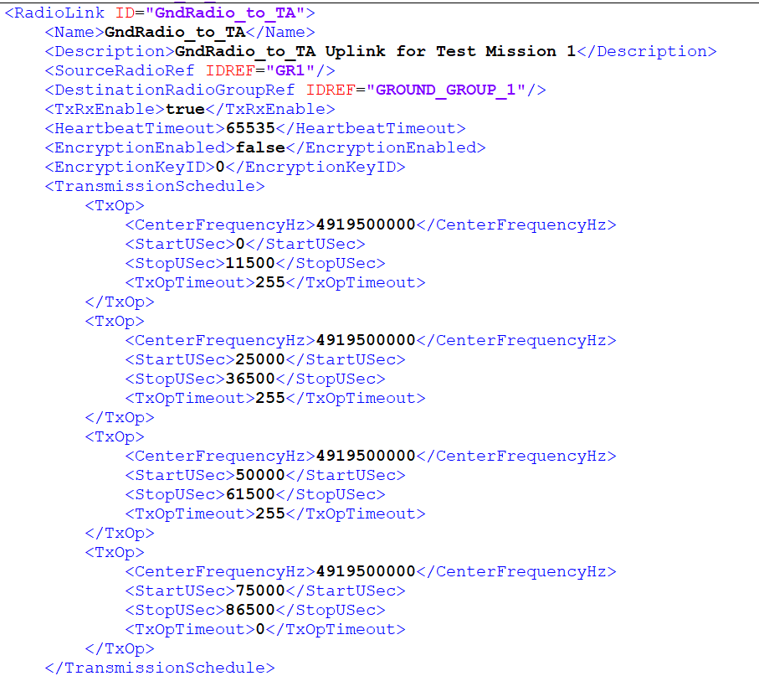
TA Radio MDL Configuration - Before
Ground Radio MDL Configuration – Before

Slide 25
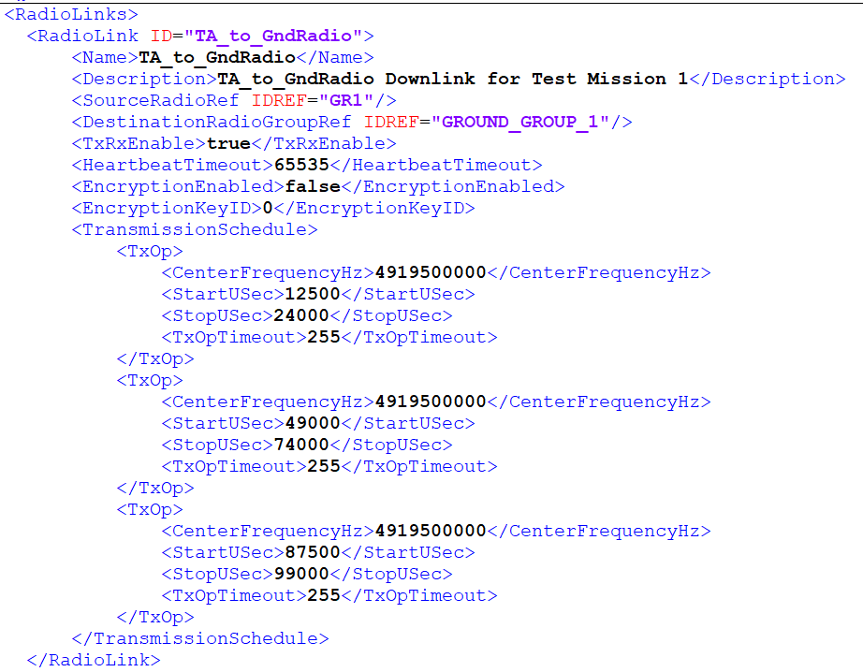
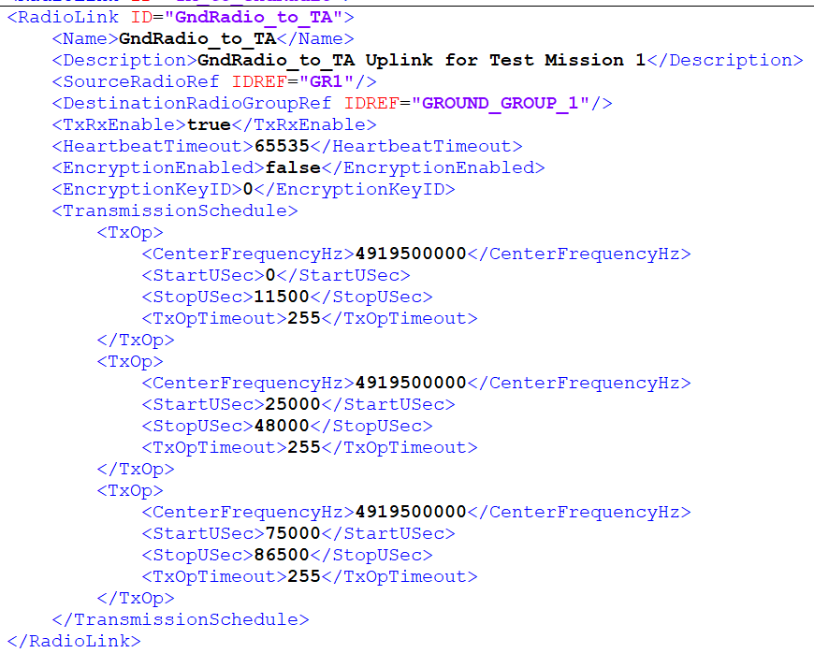
TA Radio MDL Configuration - After
Ground Radio MDL Configuration – After

Slide 26
Transmission Schedule Before Adaptation
GR-TA: 0 ms – 11.5 ms
TA-TA: 12.5 ms – 24 ms
TA-TA: 25 ms – 36.5 ms
TA-GR: 37.5 ms – 49 ms
GR-TA: 50 ms – 61.5 ms
TA-TA: 62.5 ms – 74 ms
TA-TA: 75 ms – 86.5 ms
TA-GR: 87.5 ms – 99 ms
GR-TA
TA-GR
GR-TA
TA-GR
GR-TA
TA-GR
GR-TA
TA-GR
1ms
1ms
1ms
1ms
1ms
1ms
1ms
#1 RF Transmission: 25ms
#2 RF Transmission: 25ms
#3 RF Transmission: 25ms
#4 RF Transmission: 25ms
Epoch Size: 100 ms
Requirement: 50ms latency (actual is 25 ms)
Epoch size: 100 ms <RANConfiguration>,<EpochSize>100</EpochSize>
We suggest, to have 4 transmission per link then I need 100/25=4
We configured our Guard Band to be 1 ms
<RANConfiguration ID="RANConfig1">
<MaxGuardTimeSec>0.001</MaxGuardTimeSec>

Slide 27
Transmission Schedule After Adaptation
GR-TA
TA-GR
GR-TA
TA - GR
GR-TA
TA-GR
1ms
1ms
1ms
1ms
1ms
#1 RF Transmission: 25ms
#2 RF Transmission: 50ms
#3 RF Transmission: 25ms
Epoch Size: 100 ms
GR-TA: 0 ms – 11.5 ms
TA-TA: 12.5 ms – 24 ms
TA-TA: 25 ms – 48 ms
TA-GR: 49 ms – 74 ms
TA-TA: 75 ms – 86.5 ms
TA-GR: 87.5 ms – 99 ms
We are still meeting the latency of 50ms requirements.

Slide 28
Rules
We presented one sample transmission schedule
Others can also be an option as long as it meets the latency requirement

Slide 29
sources
https://www.pmi.org/learning/library/project-management-cost-estimate-costs-5256
http://www.businessinsider.com/air-force-plane-cost-per-flight-hour-chart-2016-3
F22 and F35
http://nation.time.com/2013/04/02/costly-flight-hours/
https://www.rand.org/content/dam/rand/pubs/research_reports/RR1100/RR1178/RAND_RR1178.pdf

